Slide 1
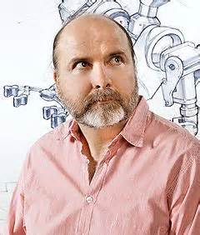
Internet could crash-We need a plan B
A TED talk by Danny Hillis, an inventor, scientist, author and engineer
One of the first users of Internet
Risks with Internet now and then
Scenario back in 1982-Directory
for phone numbers and mail ID’s

Slide 2
How was it managed?
All users trusted each other
Restricted themselves only to what they needed
Passed messages on each other’s behalf when bandwidth was low

Slide 3
Scenario now
Trust is much lower nowadays
We are dealing it with smaller walled networks: VPNs and sub networks
These imitate the internet on a smaller scale
Despite these securities,
The internet protocols are still vulnerable to attack and silly mistakes

Slide 4
Examples of IP vulnerability
Youtube was blocked in all of Asia because of an error in Pakistan’s protocols.
An issue caused by China’s telecom department made,
A large proportion of US internet traffic (including defense networks) went through China.

Slide 5
Plan B ?
Internet security tends to focus on target’s computers, and not on internet itself
A separate system independent of the internet as a ‘backup’ if the internet is taken down by attacks.
Needn’t be as big nor complicated
Something to allow emergency services to keep communication going.

Slide 6
My Thoughts
He mentions the technical details are easy to design
perhaps he should put a proposal forward with a ‘build it and they will come’ philosophy.
That can make clear what he is proposing and what functionality it would give.
Until then it is hard to imagine what we need from a ‘backup internet’.

Slide 7
Thank You
Subathra P

